Slide 1
Competition Bridge Tester
Carter Mealey
Ben Holleran

Slide 2
Preliminary Specs
1 meter Span – Trotski Competition
5 Tons – Current Record 3.2 Tons
Movable by Two People
Displays Load on Large Display
Accurate to 1% Load
Precise to 1 lb During competition
8” Active Distance

Slide 3
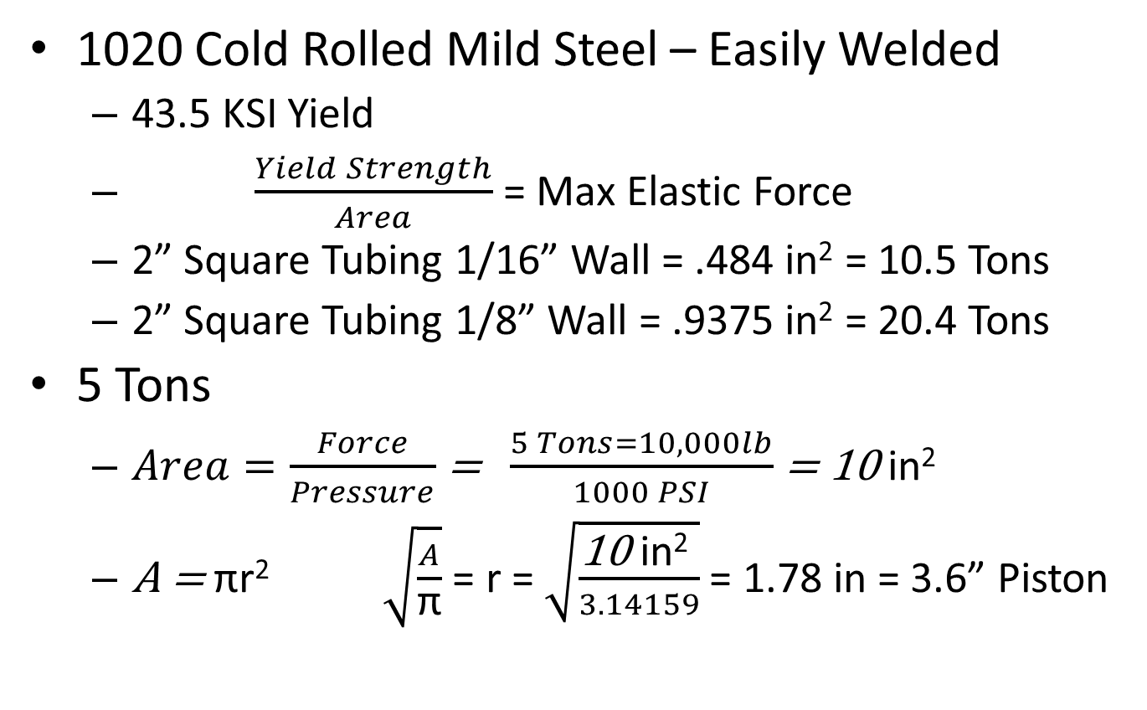
Preliminary Calculations
1020 Cold Rolled Mild Steel – Easily Welded
43.5 KSI Yield
$\frac{Yield Strength}{Area}$ = Max Elastic Force
2” Square Tubing 1/16” Wall = .484 in² = 10.5 Tons
2” Square Tubing 1/8” Wall = .9375 in² = 20.4 Tons
5 Tons
$Area=\frac{Force}{Pressure}$ = $\frac{5 Tons=10,000lb}{1000 PSI}$ = 10 in²
A = πr² $\sqrt{\frac{A}{\text{π}}}$ = r = $\sqrt{\frac{\text{10 }\text{in}\text{2} }{3.14159}}$ = 1.78 in = 3.6” Piston

Slide 4
Brainstorming

Slide 5
Tech to use / Research

Slide 6
Communication

Slide 7
Research results

Slide 8
System Diagram

